Slide 1

CAPSTONE PROJECT
Secure Data Hiding In Images Using Steganography
Presented By: Roseni A N
Student Name : Roseni A N
College Name & Department : Bishop Heber College, Tamil Nadu &MSc Information Technology

Slide 2
OUTLINE
Problem Statement
Technology used
Wow factor
End users
Result
Conclusion
Git-hub Link
Future scope

Slide 3
Problem Statement
Ensuring data security and privacy is of utmost importance in the current digital era. Conventional encryption techniques are frequently vulnerable to being discovered and intercepted. In order to address this issue, our research uses steganography to conceal confidential communications inside pictures. By providing a secret communication route, this technique improves data confidentiality without arousing suspicion.

Slide 4
Technology used
1. Programming Language:
Python → The main language for developing the application.
2. Libraries & Frameworks:
OpenCV (cv2) → For image processing and extracting hidden bits.
Tkinter → For building the graphical user interface (GUI).
ttk (Themed Tkinter Widgets) → For modern UI elements like buttons and entry fields.
ScrolledText → For displaying decrypted messages in a scrollable text box.
File Dialog (tkinter.filedialog) → For selecting encrypted images from the file system.
3. Encryption & Decryption Concept:
LSB (Least Significant Bit) Steganography → Extracts hidden data from image pixels.
4.Platform: Cross-platform (Windows/Linux)
5.Tools: Visual Studio Code

Slide 5
Wow factors
Modern Dark-Themed UI: A visually appealing and intuitive interface
Styled Text Fields and Buttons: Improved Interaction and Readability
Passcode Masking: A private, secure input field
Simple decrypted message viewing with a scrollable output box
Error Handling and Notifications: Immediate input for improved usability
Drag and Drop File Selection: A quicker method for encrypting and decrypting files
An additional degree of protection is provided by image-based passcodes.
More interactive experience with desktop notifications and success/error sounds
A sneak peek Selected Image: Verification visually prior to processing
Light, Medium, and High Encryption Levels: Adaptable security choices

Slide 6
End users
Privacy-Aware Individuals: Use pictures or files to conceal private messages.
Companies and corporations should safeguard confidential information.
Law enforcement and intelligence organizations can safely send sensitive data.
Game developers could incorporate digital signatures or hidden easter eggs into their games.
Professionals in cybersecurity: Test and improve safe communication techniques.
For safe transmission, journalists and whistleblowers should hide critical information in media files.
Watermarking artwork and avoiding copying is important for artists and digital creators.
Protect confidential communications and conceal critical information for military and defense organizations.

Slide 7
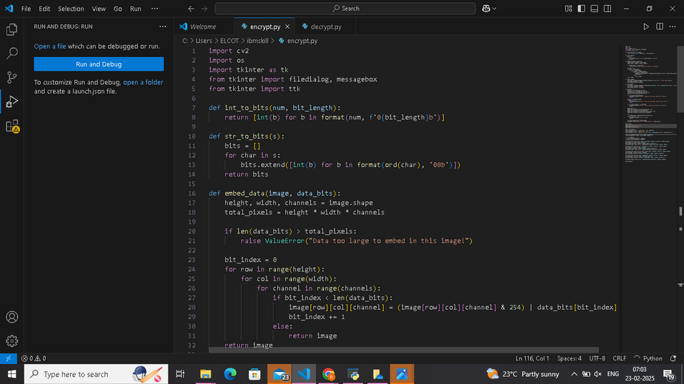



Results

Slide 8
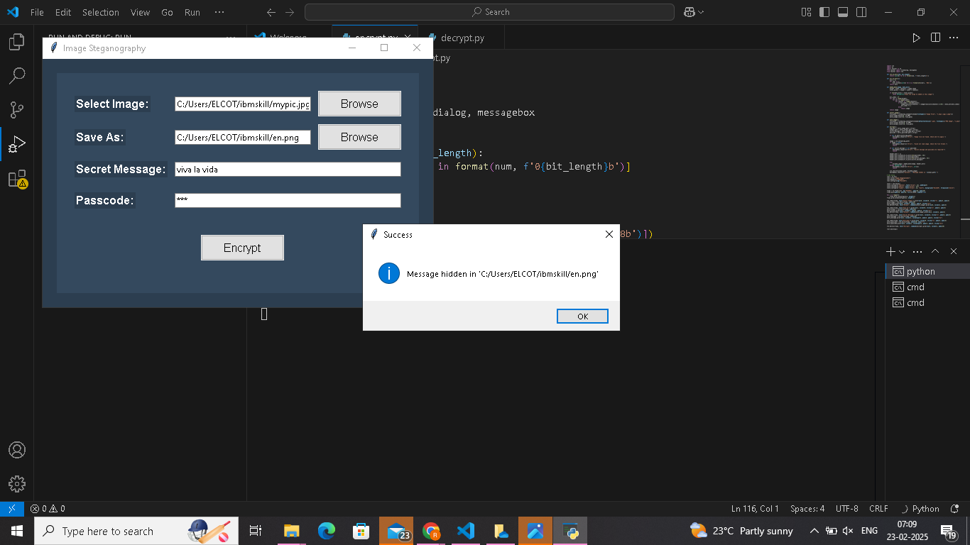
Results

Slide 9



Results

Slide 10
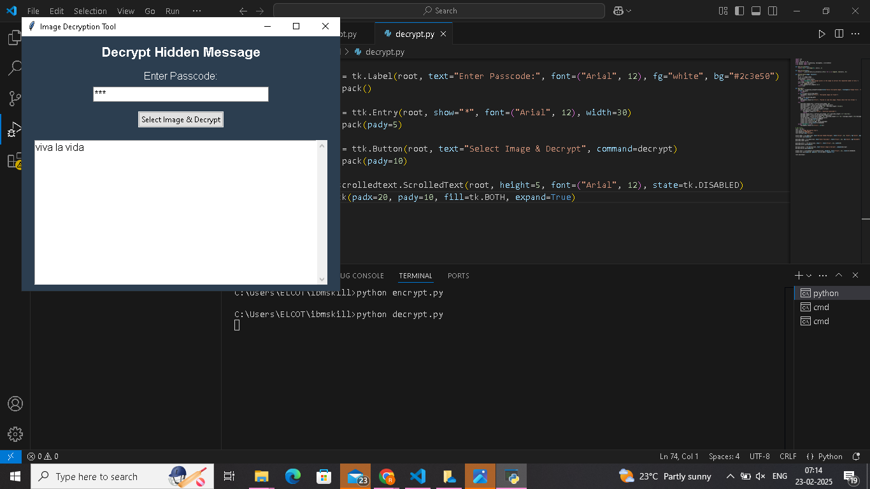
Results

Slide 11
Conclusion
Steganography is a useful method in many different fields because it can safely incorporate secret information in digital media. It is essential for protecting sensitive material in a variety of fields, including journalism, business security, personal privacy, and even military defense. Steganography keeps developing as a result of cybersecurity breakthroughs, providing better encryption and concealment strategies. User-friendly user interfaces, encryption levels, and other security measures can all be integrated into this technology to offer a smooth and efficient method of protecting data in the digital realm.

Slide 12
GitHub Link
https://github.com/roseni94/Roseni-A-N-Secure-Data-Hiding-In-Images-Using-Steganography

Slide 13
Future scope(optional)
Advanced Encryption Integration: For increased security, combine steganography with AES, RSA, or quantum encryption.
AI-Powered Steganography: This technology uses machine learning to identify steganalysis efforts and optimize concealment strategies.
Secure communication during VoIP calls and live video streaming is possible with real-time steganography.
Blockchain for Secure Storage: To ensure tamper-proof security, concealed data can be included in blockchain transactions.
Steganography in IoT and Smart equipment: Protecting communications in military systems, smart homes, and medical equipment.
Digital forensics and deepfake detection: identifying phony media and confirming the legitimacy of concealed messages.
Cloud & Distributed Storage: Using decentralized networks and cloud storage to conceal encrypted data.

Slide 14
THANK YOU

